Slide 1
IO3- MathE teachers and students Community of Practices

Slide 2
IO3- MathE teachers and students Community of Practices
Objectives of the
Community of Practice
  Promote the exchange of teaching experiences between math teachers and students.
  Share innovative teaching tools and active learning tools, in order to motivate the students to learn math.
  Share the experiences relative to MathE portal.
  Share the best practices in and out classroom.
  Discuss some difficulties with specific problems.

Slide 3
IO3- MathE teachers and students Community of Practices
Contents
  MathE Around the World
  Online Guidebook
  Teachers Forum
  Students Forum

Slide 4
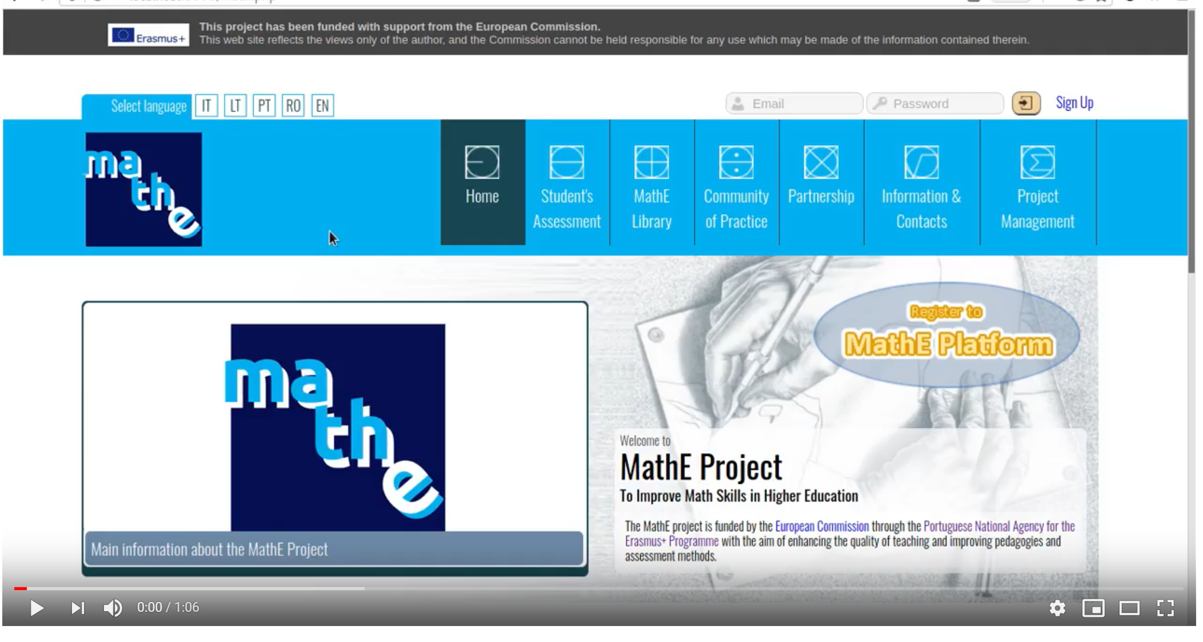
IO3- MathE teachers and students Community of Practices
MathE Around the World

Slide 5
IO3- MathE teachers and students Community of Practices
Online Guidebook
  Technical Issues about the Platform – EuroED partner
  Case Studies Using MathE Platform (>=2 per partner) – All HEI partners
  Book edition – EuroED partner

Slide 6
IO3- MathE teachers and students Community of Practices
Teachers Forum - share
  Innovative Tools (Elearning,… )
  Active Learning Tools (Problem based learning; Inquiry based learning;….)
  Experiments

Slide 7
IO3- MathE teachers and students Community of Practices
Students Forum - share
  Questions
  Experiments
  Comments
  Problems

Slide 8
IO3- MathE teachers and students Community of Practices
Teachers/Students Forum
  Select Topic/Subtopic - > Appear the comments
  Select Topic/Subtopic and keyword - > Appear the comments
  No selection - > All comments

Slide 9
IO3- MathE teachers and students Community of Practices
Teachers/Students Forum
  An user can put a comment in the forum associated to a discussion of: a general issue; a topic/subtopic content; topic/subtopic and keyword area
  Teachers can answer/comment in the Teacher and Student Forums'
  Students can participate only in the Student Forum
  Admin can delete comments
  Admin can eliminate a user (black list)

Slide 10
IO3- MathE teachers and students Community of Practices
Deadlines
  31 January 2020 – MathE around the World - IPB
  30 March 2020 – Guidebook – Part 1: MathE usability - EuroEd
  30 October 2020 – Guidebook – Part 2: MathE experiments – All HEI
  30 November 2020 – Guidebook Edition – EuroEd
  30 June 2020 – Teacher/Student Forum – Pixel

